Slide 1
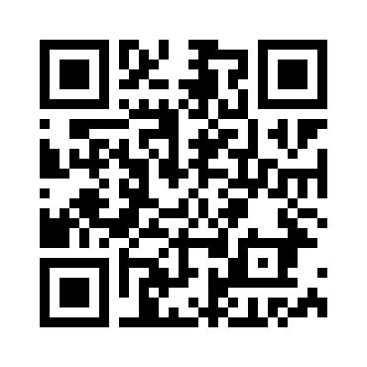

Brief intro to Git
Install: https://git-scm.com/install/
Add to PATH when prompted
https
://github.com/skjoldan000/CognitiveModeling2026
Create your own github account (optional for now)
https://github.com/signup

Slide 2
What is git and why is it useful
Git is version control system
Allows you “save” many versions of the same file(s) as you are working on them; often scripts, but can also be text files, e.g. latex
Avoid “script_3_final_2(3).r”
Allows you to track changes you make as you work, and leave log messages about the changes you made
Minimises storage space by on saving “diffs” between versions
Allows multiple people to work on the same project and merge changes

Slide 3
How to work with git
Work with files as you normally would (working dir)
Once you have a set of changes, add them to staging
Commit the staged changes to local repo, with message
Push changes to remote repo for backup/collaboration
add
commit
push
Working directory
(local file system)
Staging
(what should be added to local repo)
Local repository
(local version control)
Remote repository
(hosted somewhere, e.g. GitHub)
restore
merge
fetch
pull

Slide 4
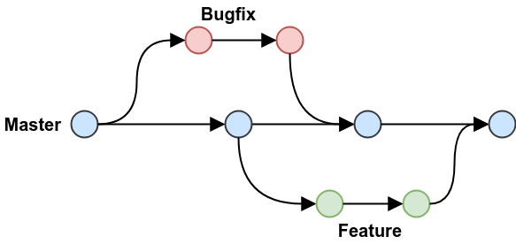
Branches

Slide 5
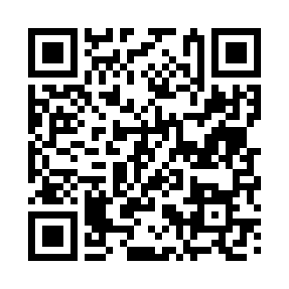
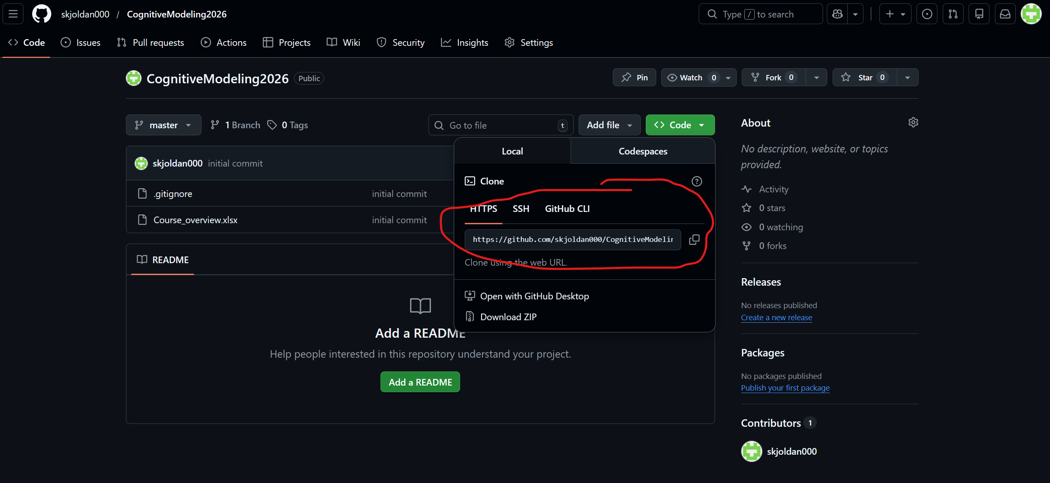
Go to link
https://github.com/skjoldan000/CognitiveModeling2026

Slide 6
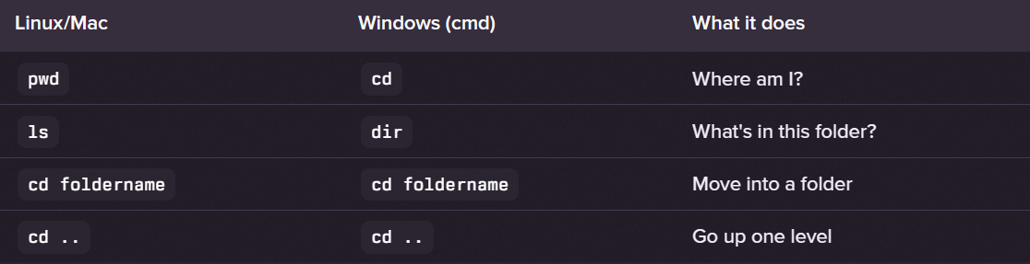
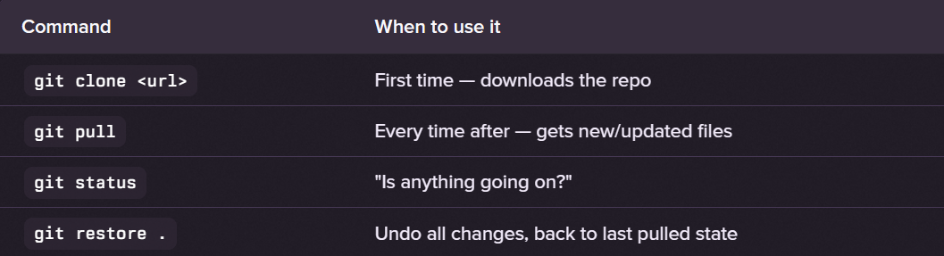
Terminal commands
For now, if you want to make changes in one/more of the files, e.g. for experimentation, copy that file first.
This will avoid merge conflicts, if both you and I have modified the same parts of the same file next time you git pull
Git commands

